Slide 1

PI and Thermal Simulation Study for BD9G341EFJ Board
October 24th, 2014
Hosted by: Xuan Dang/Chuong Ngo

Slide 2
Agenda
Introduction
DC Drop Analysis
Current Density Analysis
Thermal Analysis
Conclusion

Slide 3
Introduction
This work considers power simulation and thermal simulation on BD9G341EFJ boards.
Based on board file BD9G341EFJ-E2EVK-101_BRD_REV00_2014-10-17_1800.brd
PowerDC software is used for simulation
PI simulation considers:
DC Drop analysis
Determine what the max drop for power rail
Current Density analysis
Determine the hot spot of current density on PCB
Thermal simulation considers:
PCB temperature profile including consideration for conductive, radiative, and convective heat transfer

Slide 4
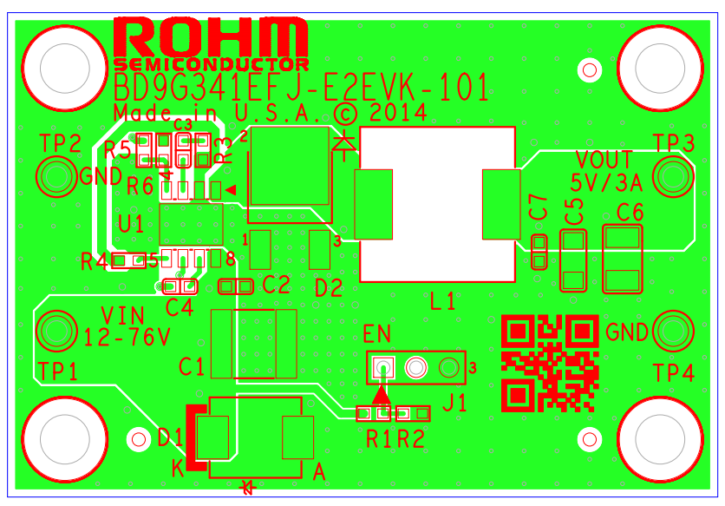
BD9G341EFJ Board
Based on the board file : BD9G341EFJ-E2EVK-101_BRD_REV00_2014-10-17_1800.brd

Slide 5
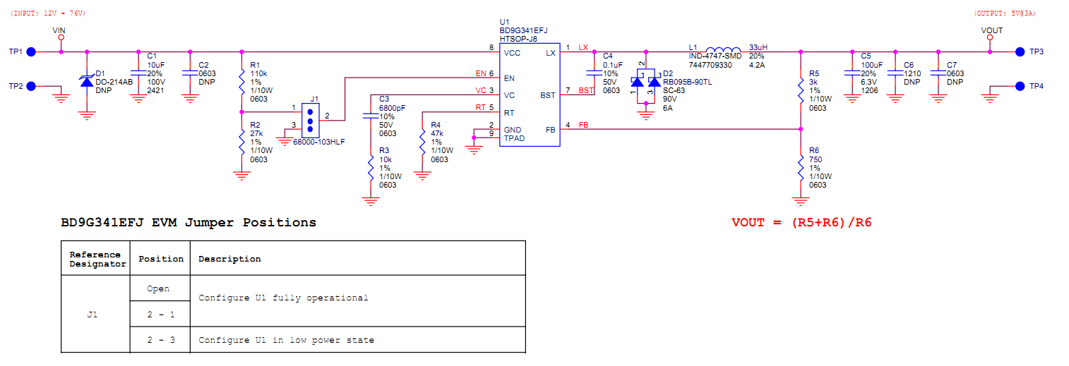
BD9G341EFJ Schematic
Based on the schematic file : BD9G341EFJ-E2EVK-101_SCH_REV00_2014-10-17.pdf

Slide 6
BD9G341EFJ Board power consumption
Device/rail | Source/VRM refdes | Source PCB netname | Sink/load PCB refdes | Load PCB net name | Nominal Voltage(V) | Voltage tolerance (%) | Max current (A) | Power input (W) | Power consumption (W) | Note
Power input via TP1/TP2 connectors (VIN 12-76V) | TP1 | VIN | U1 | VIN | 12 |  | 1.75 | 21 |  | Max input current = (Pout + PONH + Psw + Pq + PL)/VIN = 1.34A with Vin= 12 V. So we choose max input current = 1.75A
 |  |  |  |  | 76 |  | 0.253 | 19.23 |  | Per customer’s instruction, Efficiency is 78%.Max input current = Vout x Iout / Vin x ( 100 / Efficiency )= 0.253A with Vin= 76V. So we choose max input current = 0.253A
Power dissipation on BD9G341EFJ | TP1 | VIN | U1 | VIN | 12 |  | 1.75 |  | 0.702 | RONH = 0.15 Ohm , Fsw = 200KHz, Icc = 2 mA
 |  |  |  |  | 76 |  | 0.253 |  | 3.825 | Pd= Pin –Pout-PL=76*0.253-5*3-0.405=3.825W
Power dissipation on inductor L1 | U1 | LX | L1 | LX |  |  | 3 |  | 0.405 | RL = 0.045 Ohm
Power consumption at load via connector TP3/TP4 (VOUT 5V) | L1 | LX | TP3 | VOUT | 5 | 2 | 3 |  | 15

Slide 7
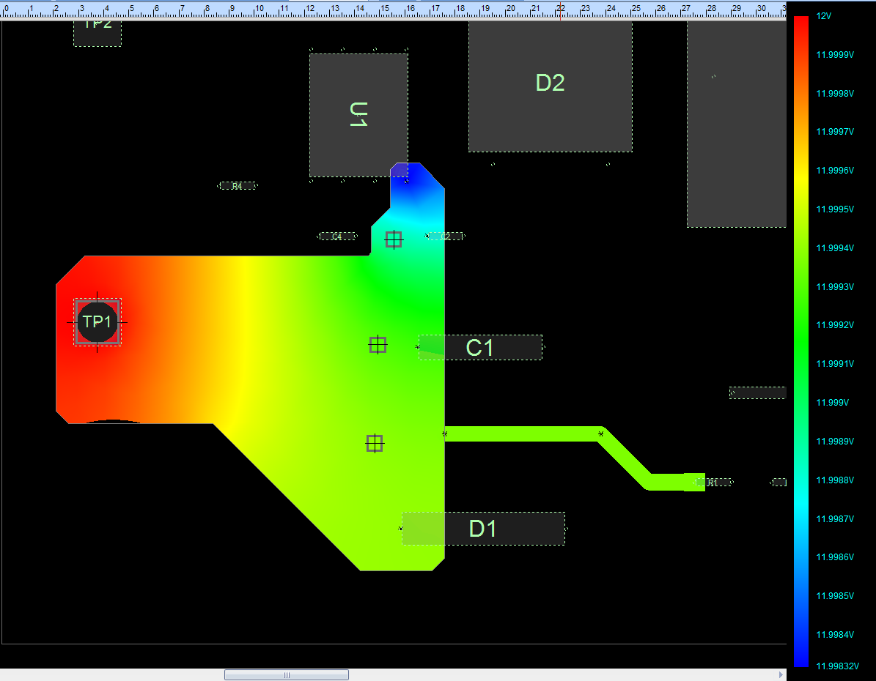
DC Drop analysis for VIN 12V@1.75A at TOP Layer
Load U1
Source TP1
Max DC Drop 1.68mV < 240mV (2% tolerance of 12V) → Copper planes for VIN is OK
10/24/2014
PTH Solutions Confidential
7

Slide 8
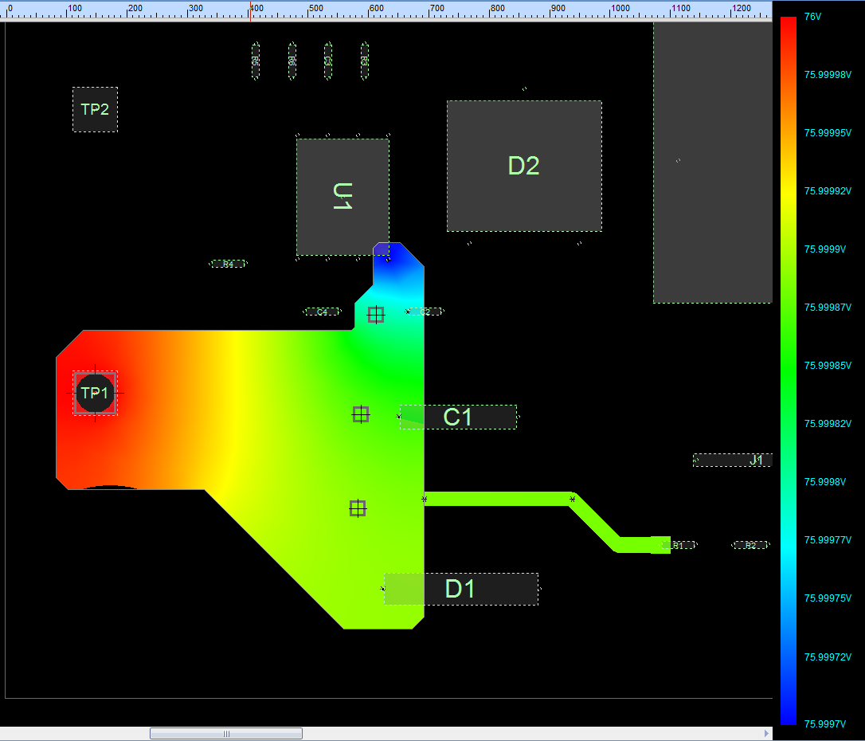
DC Drop analysis for VIN 76V@0.253A at TOP Layer
Load U1
Source TP1
Max DC Drop 0.3mV < 1520mV (2% tolerance of 76V) → Copper planes for VIN is OK

Slide 9
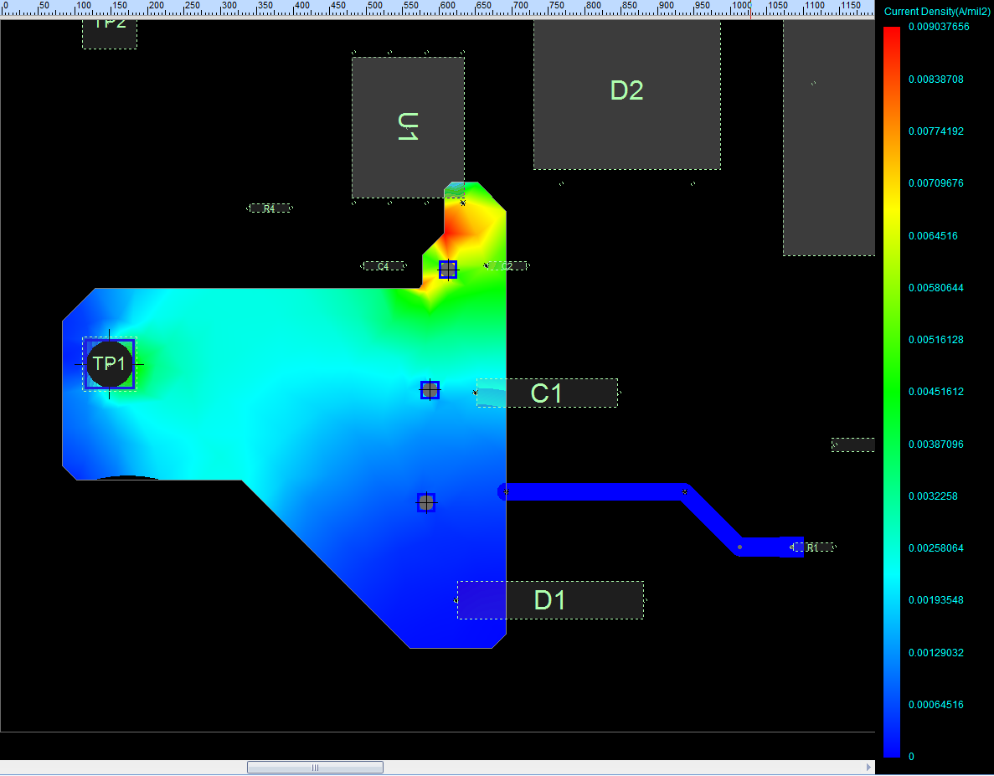
Current Density analysis for VIN 12V@1.75A at TOP Layer
Load U1
Source TP1
Max Current Density 9.04mA/mil²<40mA/mil² (This rule limit 10 Celsius degree of temperature rise above ambient) → Copper plane for VIN is OK
10/24/2014
PTH Solutions Confidential
9

Slide 10
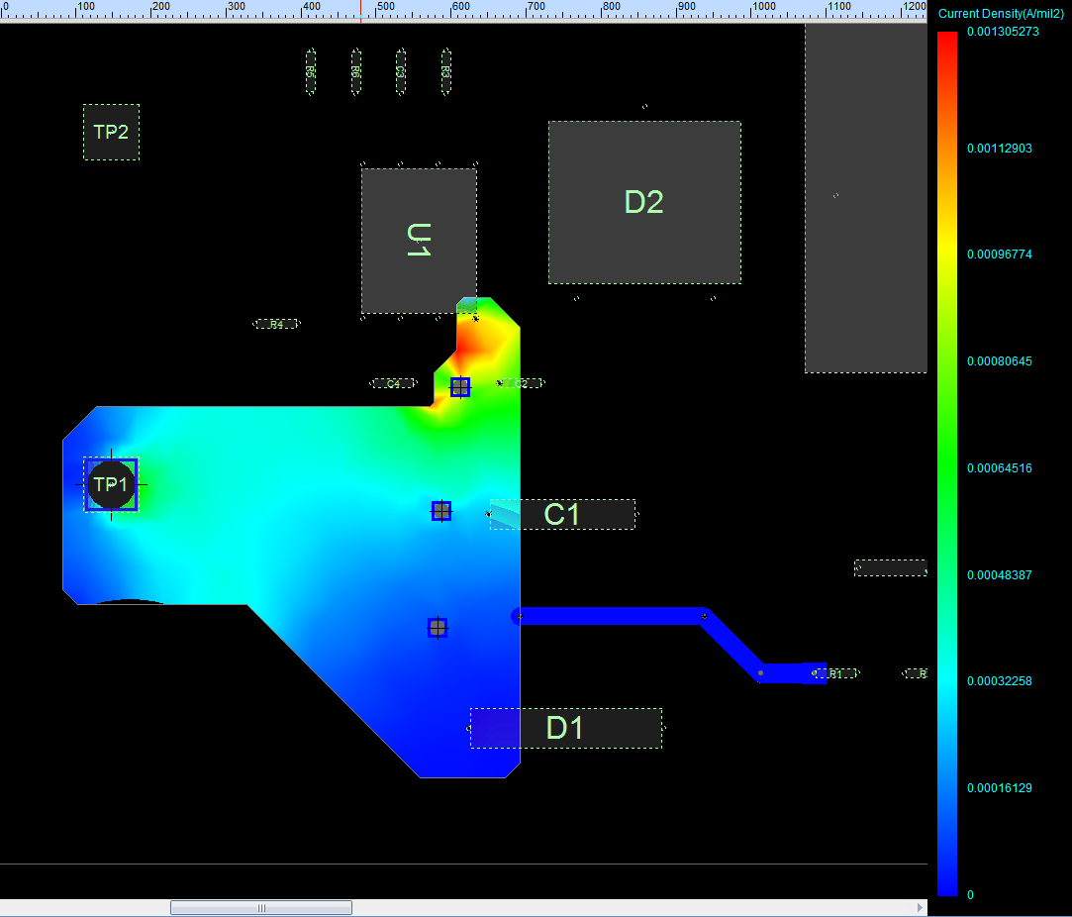
Current Density analysis for VIN 76V@0.253A at TOP Layer
Load U1
Source TP1
Max Current Density 1.31mA/mil²<40mA/mil² (This rule limit 10 Celsius degree of temperature rise above ambient) → Copper plane for VIN is OK

Slide 11
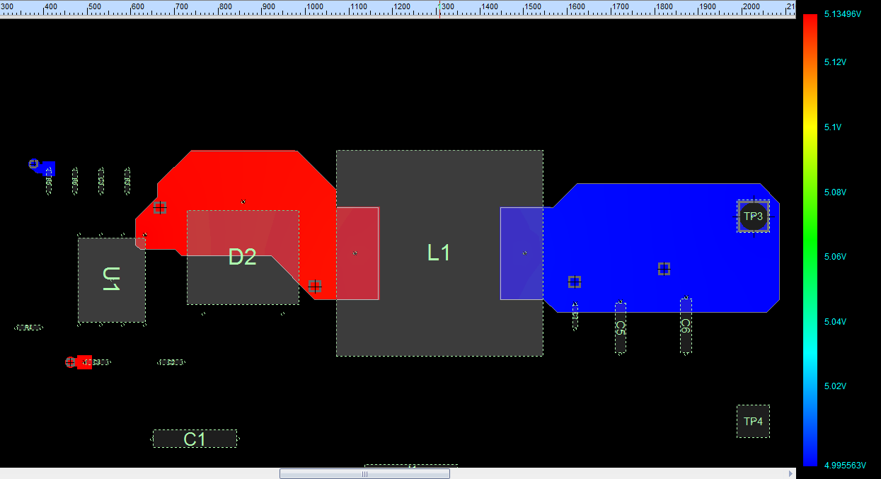
DC Drop analysis for VOUT 5V@3A at TOP layer (with Vin=12V)
Load TP3
Source L1
Max DC Drop 4.44mV < 100mV (2% tolerance of 5V) → Copper planes for VOUT is OK

Slide 12
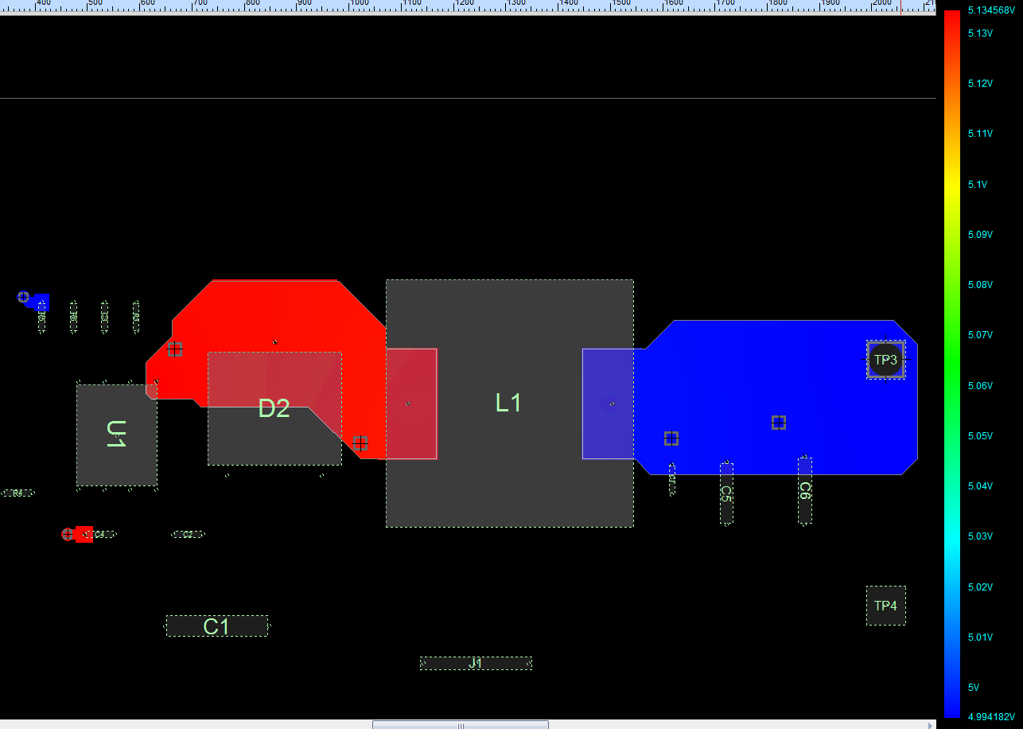
DC Drop analysis for VOUT 5V@3A at TOP layer (with Vin=76V)
Load TP3
Source L1
Max DC Drop 5.82mV < 100mV (2% tolerance of 5V) → Copper planes for VOUT is OK
10/24/2014
PTH Solutions Confidential
12

Slide 13
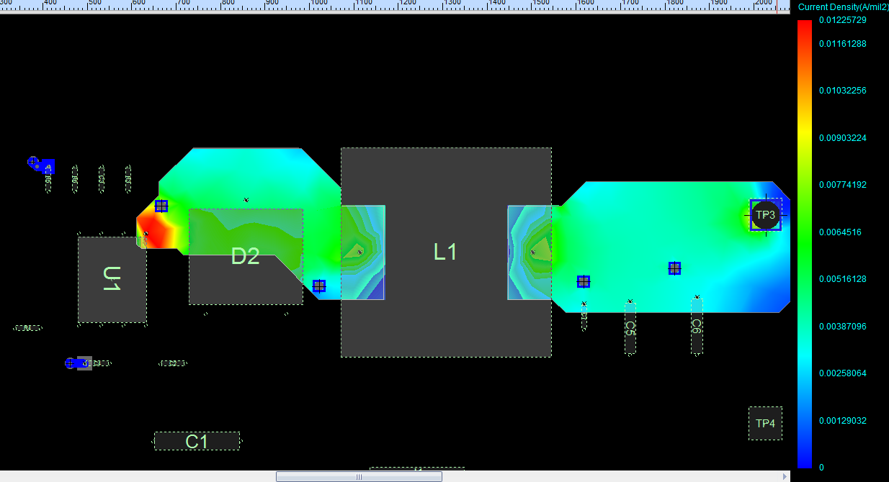
Current Density analysis for VOUT 5V@3A at TOP layer (with Vin=12V)
Load TP3
Source L1
Max Current Density 12.26mA/mil²<40mA/mil² (This rule limit 10 Celsius degree of temperature rise above ambient) → Copper plane for VIN is OK

Slide 14
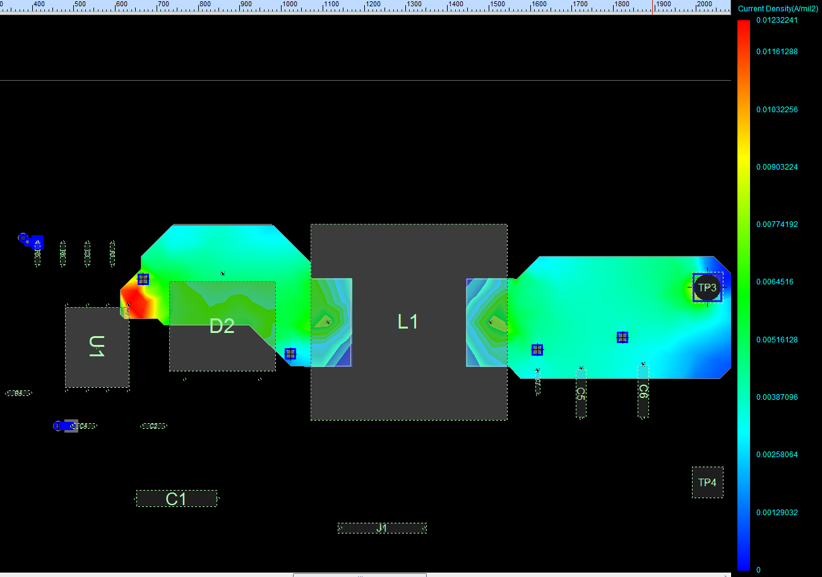
Current Density analysis for VOUT 5V@3A at TOP layer (with Vin=76V)
Load TP3
Source L1
Max Current Density 12.32mA/mil²<40mA/mil² (This rule limit 10 Celsius degree of temperature rise above ambient) → Copper plane for VIN is OK
14

Slide 15
Thermal Analysis
Environment conditions
Air Temperature : 25 ⁰C , 35 ⁰C and 45 ⁰C
No incoming air flow (Natural convection)
VOUT 20mV/div (AC)
SW 5V/div

Slide 16
Thermal Analysis (Con’t)
Component properties
 | BD9G3441EFJ (U1) | 7447709330 (L1)
Number of pins | 9 | 2
Max. power dissipation | 0.702W at VIN=12V 3.825W at Vin=76V | 0.405W
VOUT 20mV/div (AC)
SW 5V/div

Slide 17
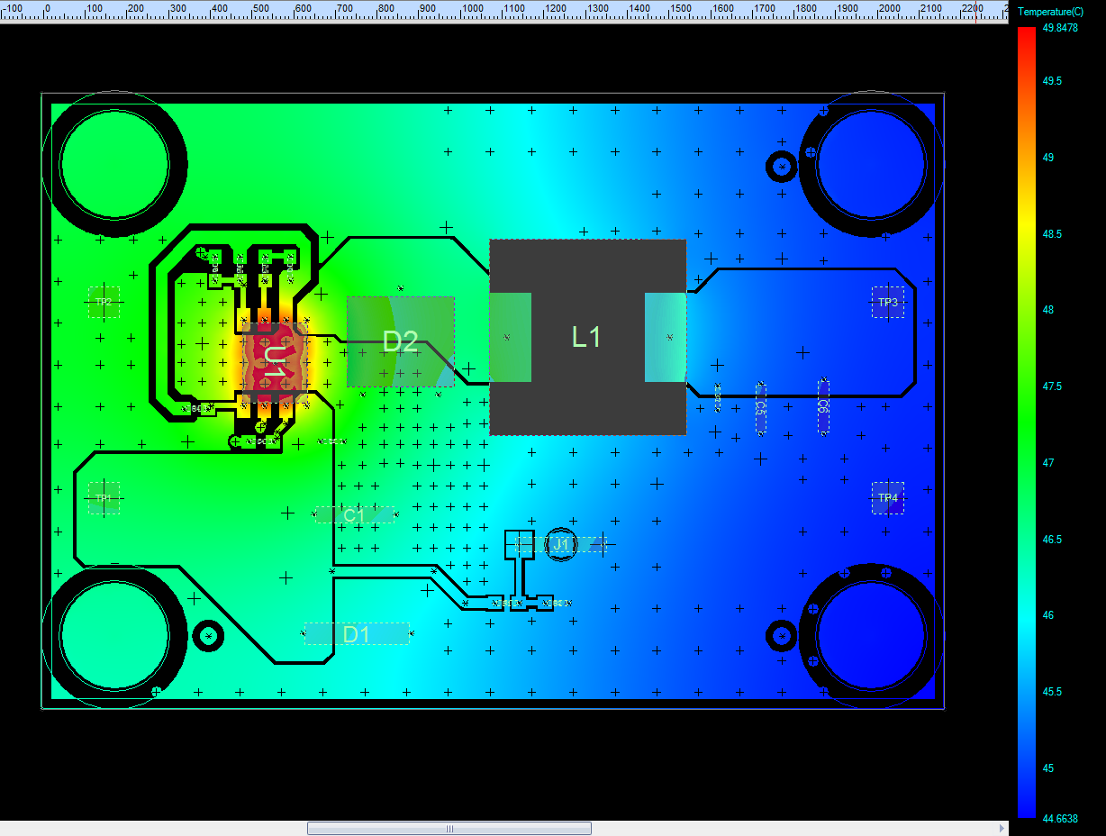
Thermal Analysis (Con’t)
Air temperature 25⁰C, power dissipation of BD9G341EFJ is 0.702W (at VIN=12V, board size : 55x37.47mm)
U1: BD9G341EFJ
Max. power dissipation: 0.702W @VIN=12V
Component temperature = 49.85 ⁰C
L1: 7447709330
Max. power dissipation: 0.405W
Component temperature = 46.8 ⁰C
The highest temperature on board is about 49.85 ⁰C
The highest temperature on component is on BD9G341EFJ( about 49.85 ⁰C)

Slide 18
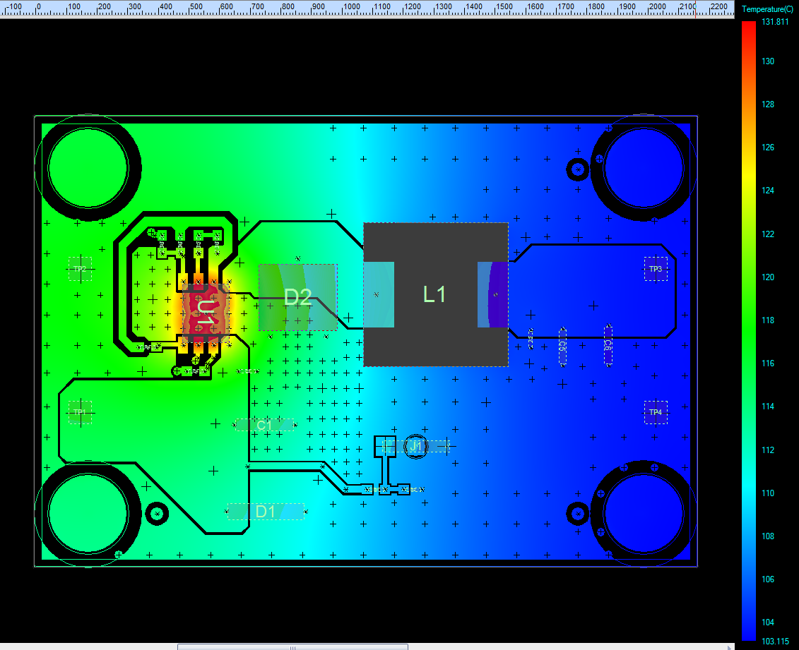
Thermal Analysis (Con’t)
Air temperature 25⁰C, power dissipation of BD9G341EFJ is 3.825W (at VIN=76V, board size : 55x37.47mm)
U1: BD9G341EFJ
Max. power dissipation: 3.825W @VIN=76V
Component temperature = 131.81 ⁰C
L1: 7447709330
Max. power dissipation: 0.405W
Component temperature = 110.2 ⁰C
The highest temperature on board is about 131.81 ⁰C
The highest temperature on component is on BD9G341EFJ( about 131.81 ⁰C)
18

Slide 19
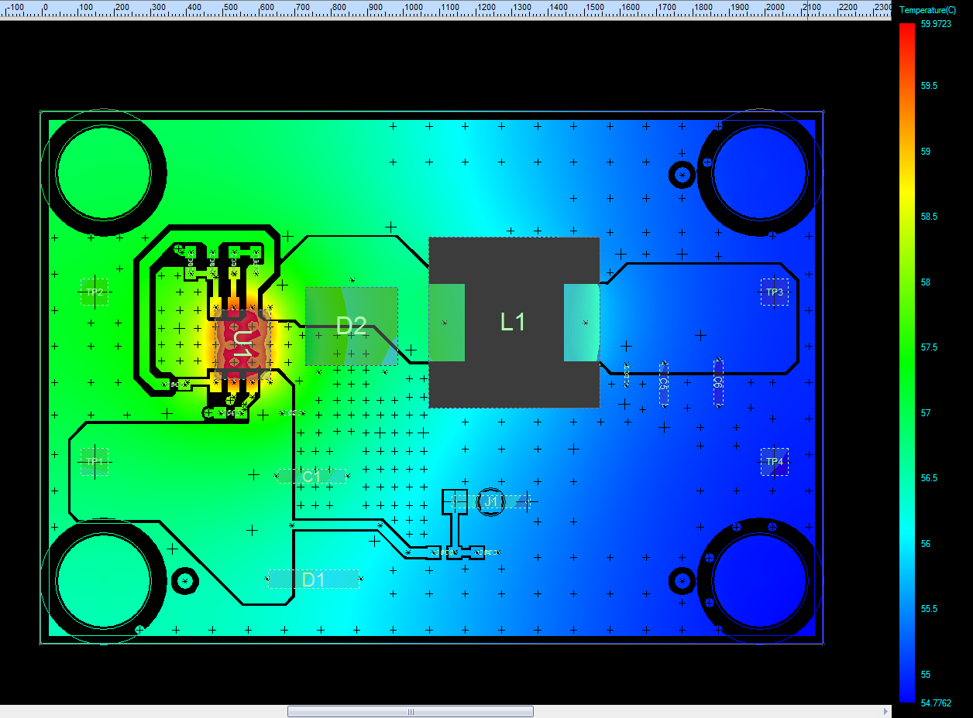
Thermal Analysis (Con’t)
Air temperature 35⁰C, power dissipation of BD9G341EFJ is 0.702W (at VIN=12V, board size : 55x37.47mm)
U1: BD9G341EFJ
Max. power dissipation: 0.702W @VIN=12V
Component temperature = 59.97 ⁰C
L1: 7447709330
Max. power dissipation: 0.405W
Component temperature = 57.48 ⁰C
The highest temperature on board is about 59.97 ⁰C
The highest temperature on component is on BD9G341EFJ ( about 59.97 ⁰C)

Slide 20
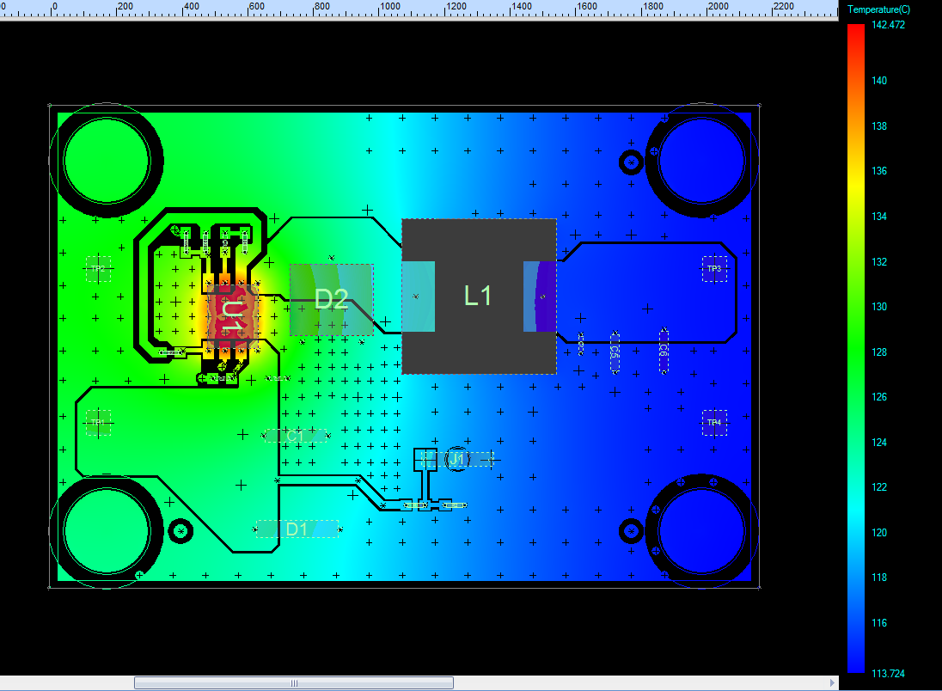
Thermal Analysis (Con’t)
Air temperature 35⁰C, power dissipation of BD9G341EFJ is 3.825W (at VIN=76V, board size : 55x37.47mm)
U1: BD9G341EFJ
Max. power dissipation: 3.825W @VIN=76V
Component temperature = 142.47 ⁰C
L1: 7447709330
Max. power dissipation: 0.405W
Component temperature = 121.02 ⁰C
The highest temperature on board is about 142.47 ⁰C
The highest temperature on component is on BD9G341EFJ ( about 142.47 ⁰C)

Slide 21
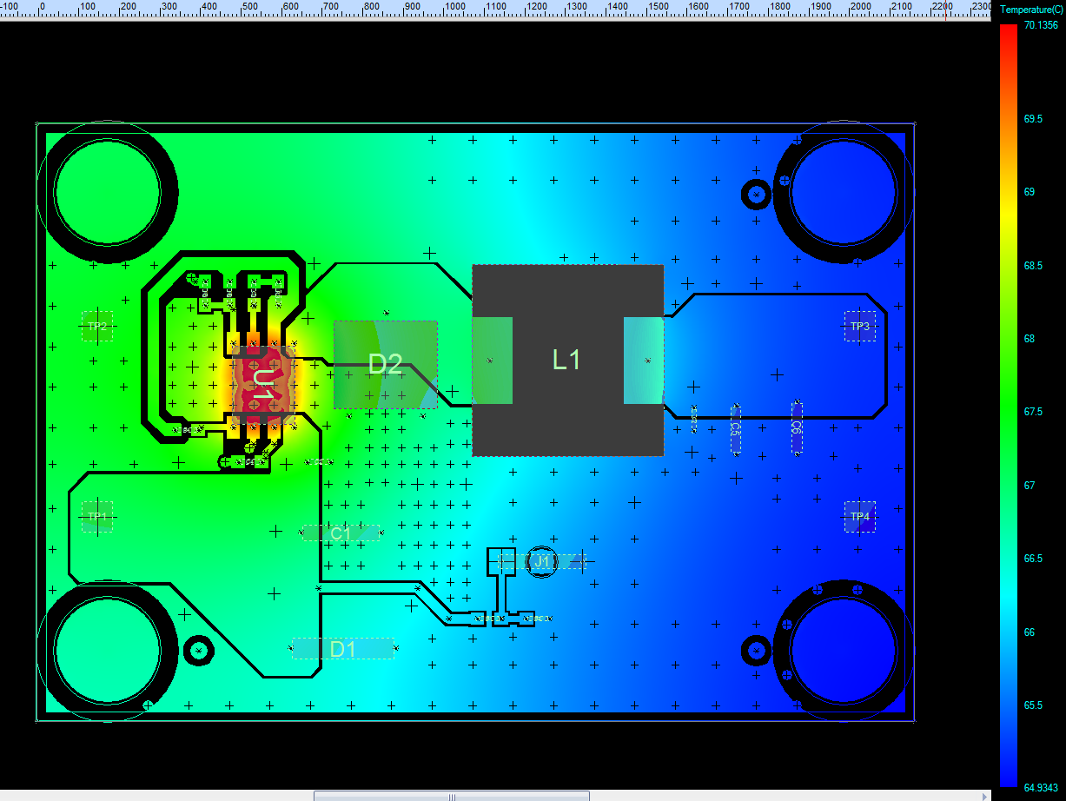
Thermal Analysis (Con’t)
Air temperature 45⁰C, power dissipation of BD9G341EFJ is 0.702W (at VIN=12V, board size : 55x37.47mm)
U1: BD9G341EFJ
Max. power dissipation: 0.702W @VIN=12V
Component temperature = 70.14 ⁰C
L1: 7447709330
Max. power dissipation: 0.405W
Component temperature = 67.56 ⁰C
The highest temperature on board is about 70.14 ⁰C
The highest temperature on component is on BD9G341EFJ ( about 70.14 ⁰C)

Slide 22
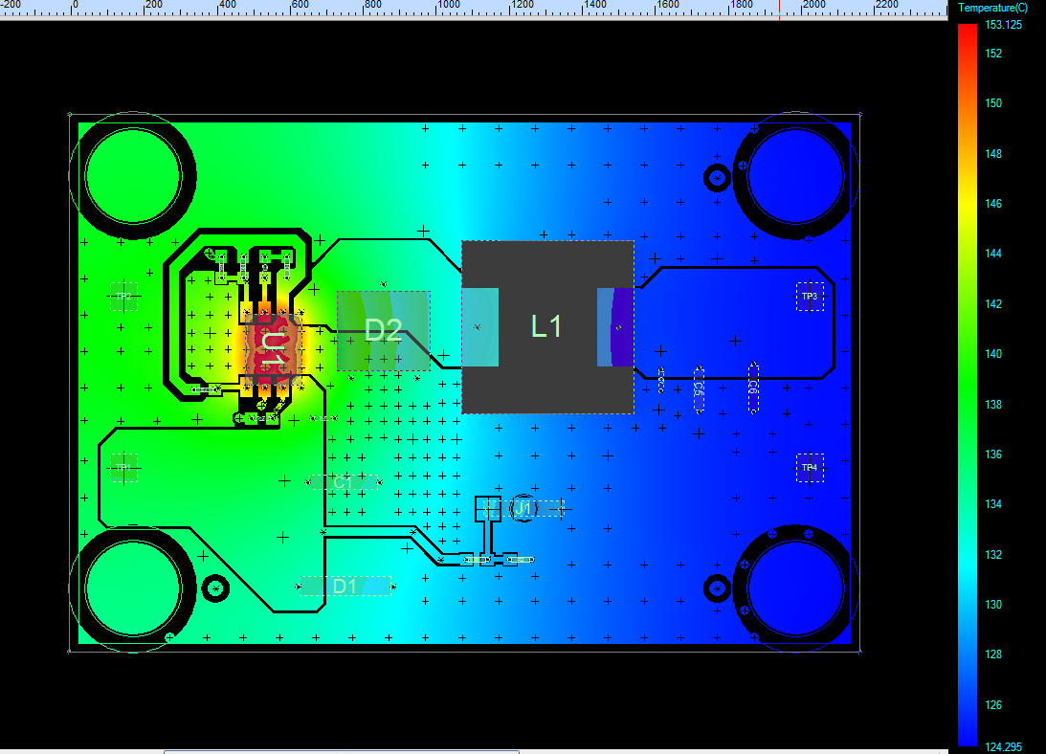
Thermal Analysis (Con’t)
Air temperature 45⁰C, power dissipation of BD9G341EFJ is 3.825W (at VIN=76V, board size : 55x37.47mm)
U1: BD9G341EFJ
Max. power dissipation: 3.825W @VIN=76V
Component temperature = 153.1 ⁰C
L1: 7447709330
Max. power dissipation: 0.405W
Component temperature = 131.7 ⁰C
The highest temperature on board is about 153.1 ⁰C
The highest temperature on component is on BD9G341EFJ ( about 153.1 ⁰C)

Slide 23
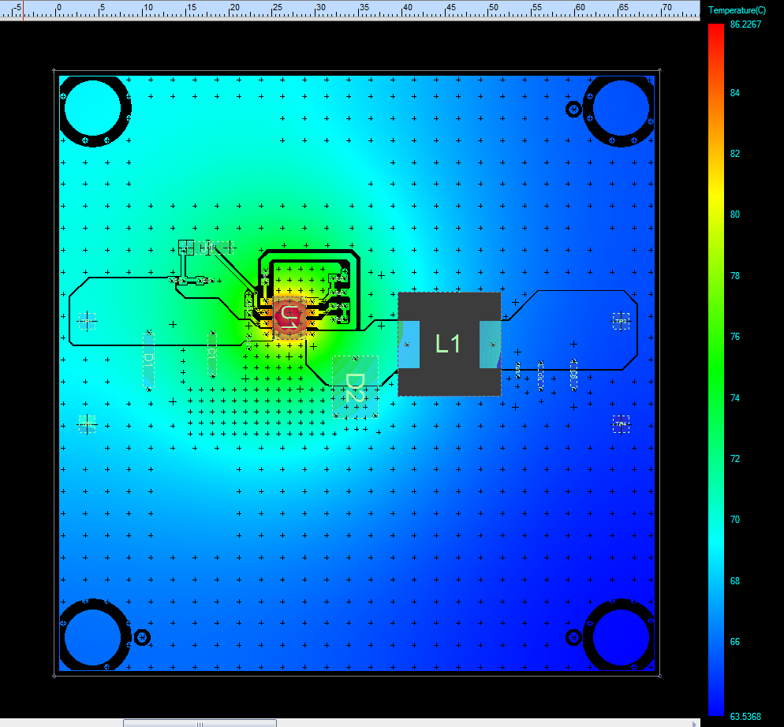
Thermal Analysis (Con’t)
Air temperature 25⁰C, power dissipation of BD9G341EFJ is 3.825W (at VIN=76V, board size : 70x70mm)
U1: BD9G341EFJ
Max. power dissipation: 3.825W @VIN=76V
Component temperature = 86.2 ⁰C
L1: 7447709330
Max. power dissipation: 0.405W
Component temperature = 70.4 ⁰C
The highest temperature on board is about 86.2 ⁰C
The highest temperature on component is on BD9G341EFJ ( about 86.2 ⁰C)

Slide 24
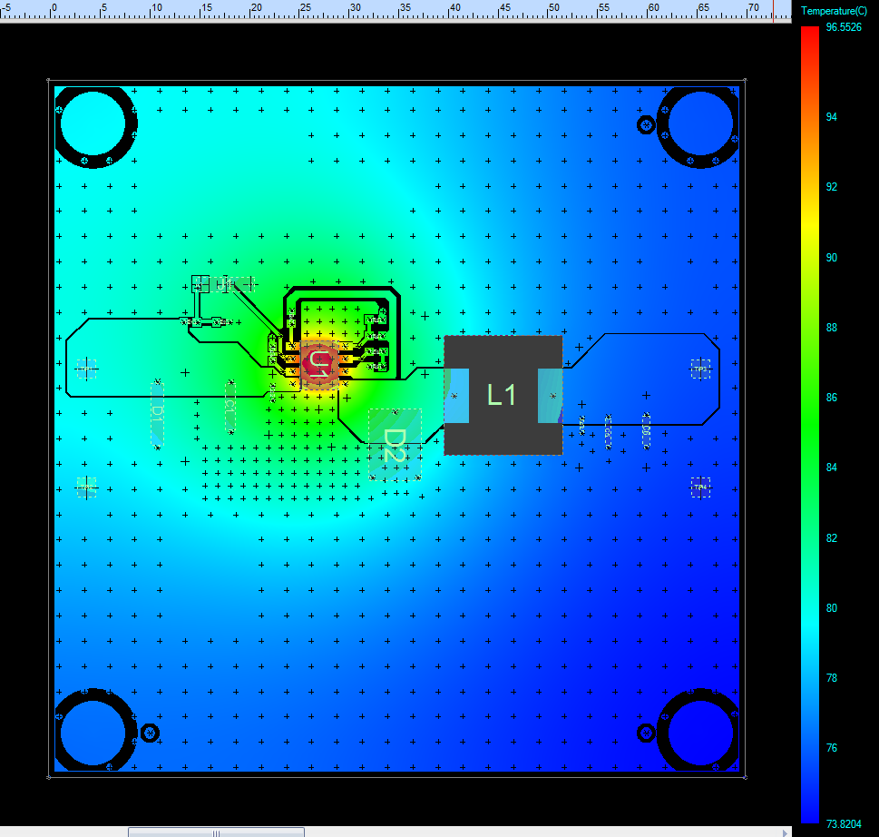
Thermal Analysis (Con’t)
Air temperature 35⁰C, power dissipation of BD9G341EFJ is 3.825W (at VIN=76V, board size : 70x70mm)
U1: BD9G341EFJ
Max. power dissipation: 3.825W @VIN=76V
Component temperature = 96.6 ⁰C
L1: 7447709330
Max. power dissipation: 0.405W
Component temperature = 80.8 ⁰C
The highest temperature on board is about 96.6 ⁰C
The highest temperature on component is on BD9G341EFJ ( about 96.6 ⁰C)

Slide 25
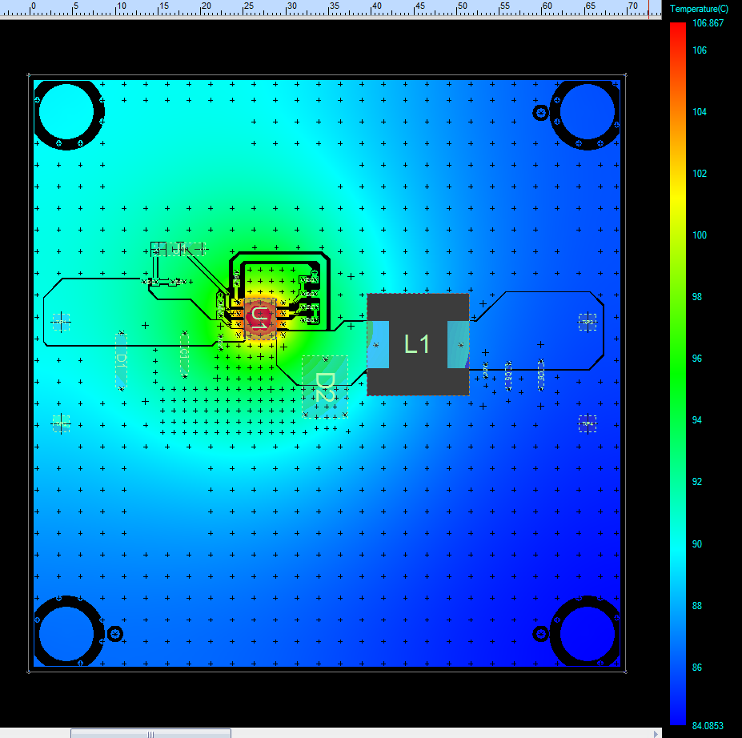
Thermal Analysis (Con’t)
Air temperature 35⁰C, power dissipation of BD9G341EFJ is 3.825W (at VIN=76V, board size : 70x70mm)
U1: BD9G341EFJ
Max. power dissipation: 3.825W @VIN=76V
Component temperature = 106.9 ⁰C
L1: 7447709330
Max. power dissipation: 0.405W
Component temperature = 91.1 ⁰C
The highest temperature on board is about 106.9 ⁰C
The highest temperature on component is on BD9G341EFJ ( about 106.9 ⁰C)

Slide 26
Summary
- With VIN=12V:the PI simulation shows that the max. amount voltage drop of VIN power is 1.68mV, the max. current density of VIN power is 9.04mA/mil²; the max. amount voltage drop of VOUT power is 4.44mV, the max. current density of VOUT power is 12.26mA/mil^{2.}
⁻ With VIN=76V:the PI simulation shows that the max. amount voltage drop of VIN power is 0.3mV, the max. current density of VIN power is 1.03mA/mil²; the max. amount voltage drop of VOUT power is 5.82mV, the max. current density of VOUT power is 12.32mA/mil^{2.}
The highest temperature of BD9G341EFJ-E2EVK-101 board can be reached temperature as table below:
 | Board Size: 55x37.47mm |  | Board Size: 70x70mm
 | VIN=12V | VIN=76V | VIN=76V
Air temperature: 25⁰C | 49.85 ⁰C | 131.81 ⁰C | 86.2 ⁰C
Air temperature: 35⁰C | 59.97 ⁰C | 142.47 ⁰C | 96.6 ⁰C
Air temperature: 45⁰C | 70.14 ⁰C | 153.1 ⁰C | 106.9 ⁰C

